Slide 1
Managing the Linux Boot Process
Configure Linux Boot Components
Configure GRUB 2

Slide 2
Booting
The process of starting or restarting a computer and loading an operating system for the user to access.
Boot environment reads a program in ROM.
Program executes operations in RAM to bootstrap OS.
Makes it available for use.
Linux must go through boot process to function.
You can configure various details of this process.

Slide 3
Boot Loader
A small program stored in ROM that loads the kernel from a storage device, and then starts the operating system.
Boot environment reads loader from ROM.
Boot loader executes operations to start boot process.
Can protect boot process with a password.
Can load multiple OSes into memory.
User must choose at boot.

Slide 4
Boot Loader Components
Component | Description
Boot sector program | First component of boot loader. Loaded by boot environment on startup with fixed 512-byte size. Main function is to load second stage.
Second stage boot loader | Loads OS and contains kernel loader.
Boot loader installer | Controls installation of drive sectors. Coordinates activities of boot sector and boot loader.

Slide 5
BIOS (Slide 1 of 2)
A standard for firmware interfaces that is stored on a computer motherboard's ROM chip.
BIOS is first to run when computer is powered on.
Can test various hardware components.
Also runs a boot loader to start an OS.
Has access to various hardware input devices.
You can make hardware-level changes through the BIOS.
Was the dominant standard for several decades.

Slide 6
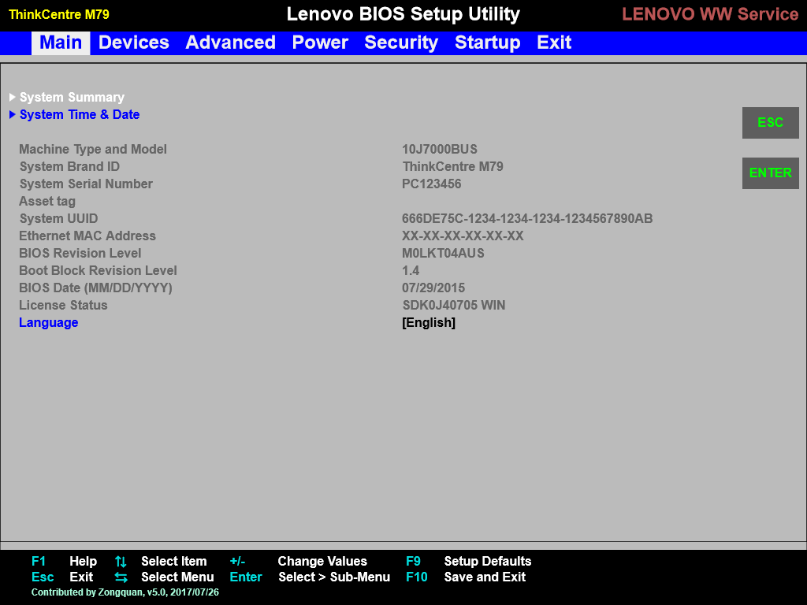
BIOS (Slide 2 of 2)

Slide 7
UEFI
Firmware technology that has largely replaced BIOS as the dominant option interface.
Advantages over BIOS:
Runs faster.
Can operate with more memory.
Can access much larger storage drives.
Can access more hardware types.
Has improved security.
Most new motherboards/PCs ship with UEFI.
Also provides environment to execute boot loader.

Slide 8
Additional Boot Options
Boot Option | Description
Boot from ISO | System image used to package and distribute OS files. Users can boot/install from ISO. Image typically written to disc/USB drive.
PXE | Enables clients to retrieve boot data from network server. Client searches for DHCP servers with PXE services. Servers transfer boot files over TFTP.
Boot from HTTP/FTP | Client can acquire boot data over HTTP/FTP. Faster, more reliable, more secure than TFTP. Open source PXE solutions support these protocols.
Boot from NFS | Client mounts NFS share rather than store files locally. Retrieves share from NFS server. DHCP/TFTP can be used to communicate boot data.

Slide 9
Sectors (Slide 1 of 2)
The smallest unit of storage read from or written to a drive.
Stores 512 bytes of data by default.
For HDDs, collection of sectors is called a track.
Number of sectors in a track varies.
So does capacity.
You can modify sector size when formatting the drive.

Slide 10
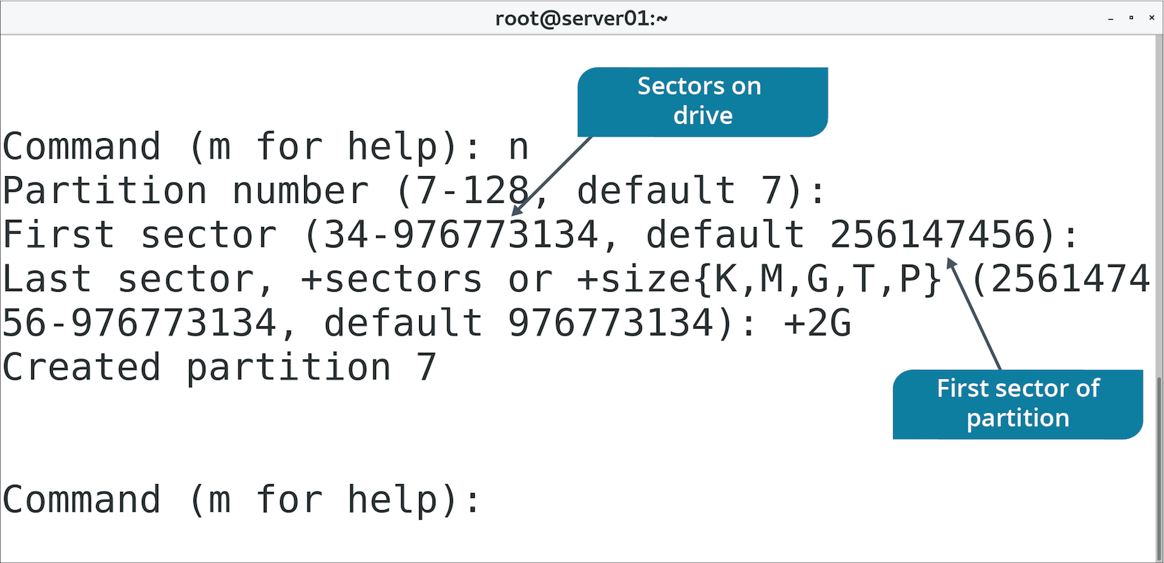
Sectors (Slide 2 of 2)

Slide 11
MBR
The first physical sector on a storage drive and a type of partition structure.
Boot sector contains boot loader.
Also contains partition table of drive.
Determines what sectors are available to each partition.
Determines which sector is bootable and which are not.
Dominant for many years in multiple OSes.
Disadvantages:
Max space of drive is 2 TBs.
Max of 4 primary partitions.
Boot data stored in only one sector.

Slide 12
GPT
A modern partition structure that is meant to replace MBR.
Makes up for MBR's shortcomings.
Part of UEFI standard.
Every partition is assigned a GUID.
Storage space and partition numbers are practically limitless.
Any limits are likely to be imposed by OS or file system.
Stores boot data in multiple locations.
Enhances redundancy.
If one location is corrupted, GPT can recover data using a copy.
Prefer using GPT over MBR.

Slide 13
initrd
The root file system that is temporarily loaded into memory upon system boot.
Loads along with kernel.
Enables system to start in two phases:
System is booted with minimal modules required to load main root file system.
Temporary file system is removed so user-space booting can continue.
Useful because many variables complicate boot process.
Kernel needs to load device driver modules.
Kernel needs to load main root file system.
Root file system could use storage methods requiring advanced setup.
The initrd handles this.
No need to hardcode behavior in kernel.

Slide 14
The initrd Image
An archive file containing all the essential files that are required for booting the operating system.
Can be built or customized.
Include additional modules.
Remove unnecessary modules.
Update existing modules.
Usually stored in /boot directory.

Slide 15
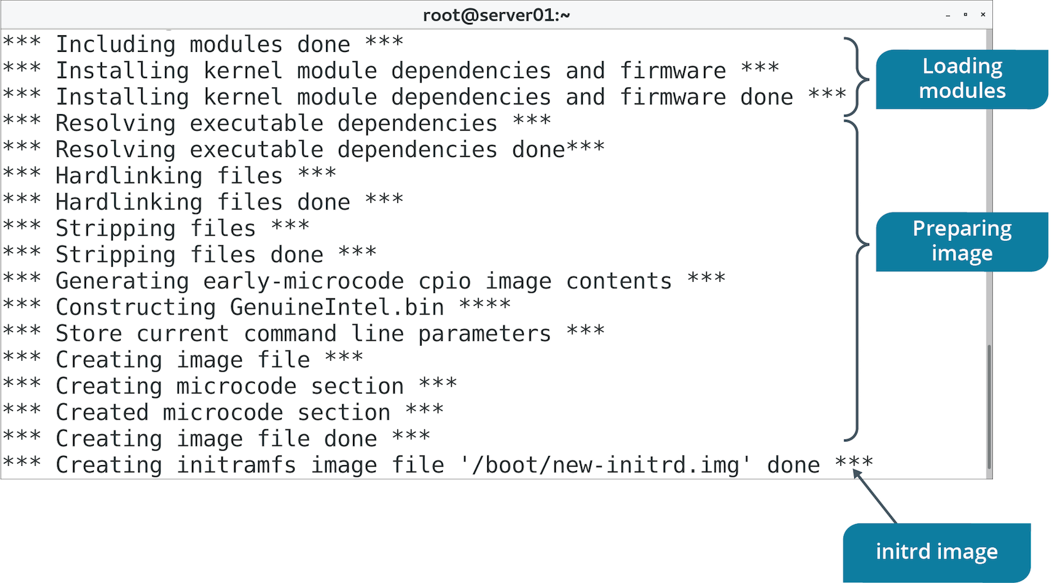
The mkinitrd Command (Slide 1 of 2)
Used to create initrd image.

Slide 16
The mkinitrd Command (Slide 2 of 2)
Option | Used To
--preload={module name} | Load module in image before loading other modules.
--with={module name} | Load module in image after loading other modules.
-f | Overwrite existing image file.
--nocompress | Disable compression of image.

Slide 17
The /boot/ Directory
Option | Description
/boot/grub/ | Contains config files for GRUB boot loader. /boot/grub2/ is for GRUB version 2.
/boot/efi/ | Contains boot files for EFI system partition (ESP). Boot loader, device driver, system app files executed by UEFI. Boot loader files named with .efi extension.
/boot/initramfs | initramfs image; alternative to initrd. Doesn't require special driver to be compiled with kernel. Dynamically sizable archive.
/boot/vmlinuz | Compressed executable of Linux kernel. Boot loader loads file into memory during boot. vmlinux is non-compressed version used for debugging.

Slide 18
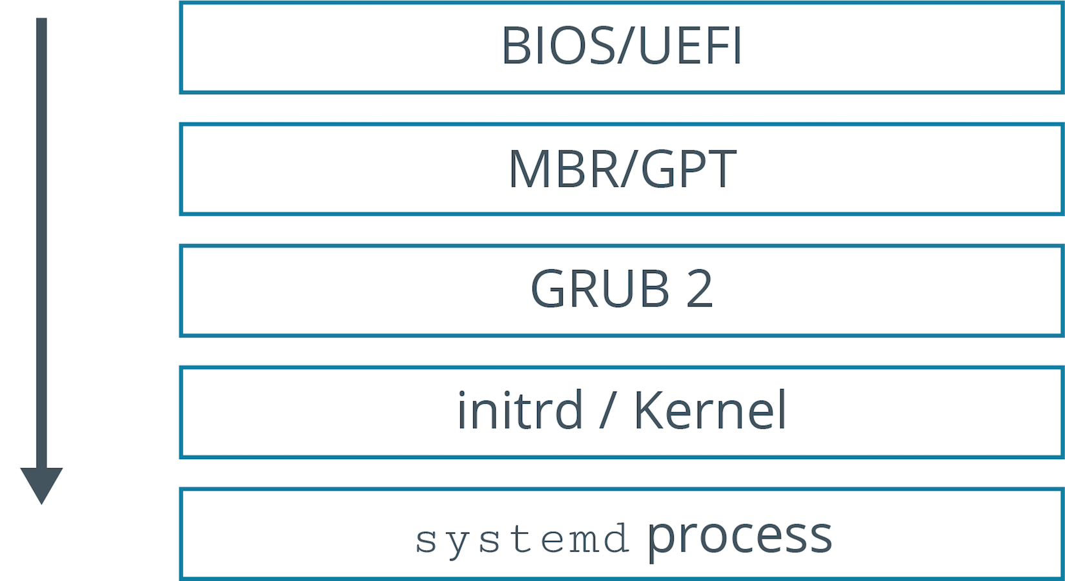
The Boot Process (Slide 1 of 2)

Slide 19
The Boot Process (Slide 2 of 2)
Processor checks for BIOS/UEFI firmware.
BIOS/UEFI checks for bootable media.
BIOS/UEFI loads primary boot loader from MBR/GPT partition into memory.
User is prompted to select system to boot; default is booted if no response.
Boot loader loads initrd image into memory and transfers control to kernel.
Kernel configures hardware drivers, decompresses initrd, and mounts it.
Kernel mounts main root partition and executes systemd program.
The system program checks the target and starts various services.
If graphical mode is selected, a display manager is started.
User enters credentials.
System authenticates user and executes profile files.
Shell is started and system is ready for use.

Slide 20
Kernel Panic
A mechanism by which the system detects there has been a fatal error and responds to it.
Fatal errors result in an unstable or unusable system.
Panic handlers display errors to user and dump kernel memory to a file.
Panic handlers will reboot automatically or wait for user.
Can happen for many reasons, but usually during boot process.
Common causes:
Kernel is corrupt.
systemd program was not executed on boot.
Kernel cannot find/mount root file system.
Malfunctioning/incompatible hardware loaded on boot.

Slide 21
Discussing the Linux Boot Process

Slide 22
Activity: Identifying Linux Boot Components
You need to become more familiar with boot components.
Will help you troubleshoot issues when loading OS onto new machines.

Slide 23
Activity: Creating an initrd Image
Some systems need to boot from NFS.
Kernel on systems doesn't have NFS module by default.
Without this, systems can't mount NFS root share.
You need to create a new initrd image for the kernel.
First you'll create a baseline image.

Slide 24
GNU GRUB
A boot loader developed by the GNU Project that became popular on Unix-like systems.
Enables users to choose which OS/kernel version to boot from.
Original version was primary boot loader for Linux distros.
Has several limitations.
Phased out in favor of GRUB version 2.
Original is called GRUB legacy.

Slide 25
GRUB 2 Improvements
Complete redesign of GRUB.
More control over boot process, devices, and behavior.
Improvements:
Support for non-x86 platforms.
Support for live booting.
Support for partition UUIDs.
Support for dynamically loading modules.
Ability to configure boot loader through scripts.
Rescue mode.
Support for custom menus and themes.
GRUB 2 is default on most modern distros.

Slide 26
GRUB 2 Installation
The grub2-install command installs GRUB 2 onto a device.
Copies GRUB 2 files into /boot/grub2 directory.
Installs GRUB 2 into boot sector on some platforms.
Applies to BIOS, not UEFI.
Use grub2-efi package to install GRUB 2 on UEFI systems.
Install through a package manager.
Copies GRUB 2 files onto ESP in /boot/efi directory.

Slide 27
The grub.cfg File (Slide 1 of 2)
Main configuration file for GRUB 2 boot loader.
Located in /boot/grub/ on BIOS systems.
Located in /boot/efi/EFI/<distro>/ on UEFI systems.
Example: /boot/efi/EFI/centos/grub.cfg
File is executable shell script.
Do not edit directly.
Generated from specific command.
Built from scripts located elsewhere.

Slide 28
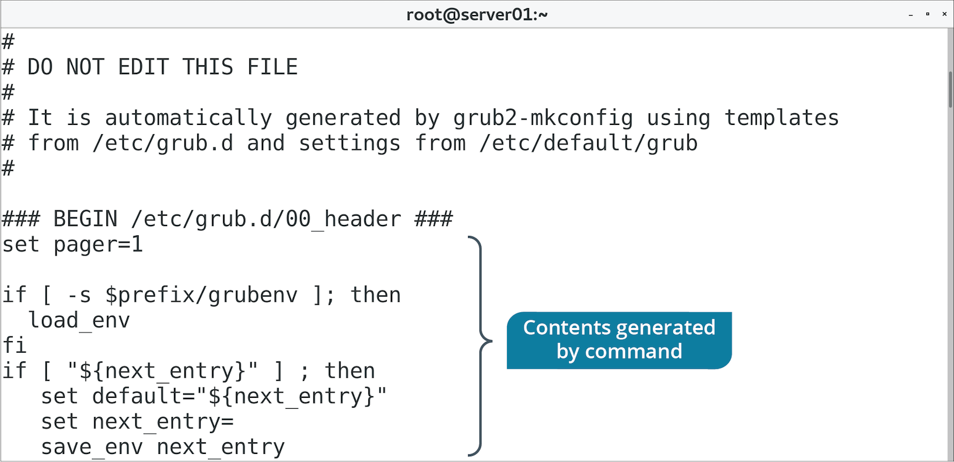
The grub.cfg File (Slide 2 of 2)

Slide 29
The /etc/grub.d/ Directory
Contains scripts used to build main grub.cfg file.
Each script provides various functions to GRUB 2.
Each script is numbered so it can be executed in order.
Not a good idea to edit existing scripts.
You can create your own and add them here.
Name them with ##_ prefix to execute in desired order.
Or, add scripts to 40_custom to execute last by default.

Slide 30
GRUB 2 Boot Menu Customization (Slide 1 of 2)
/etc/grub.d/40_custom enables customization of boot menu.
Boot menu offers user choice of which installed OS to boot from.
Multi-boot.
Boot to different kernel versions.
Boot to rescue mode.
Customization options:
Order of menu choices.
User-friendly names.
Password protection.

Slide 31
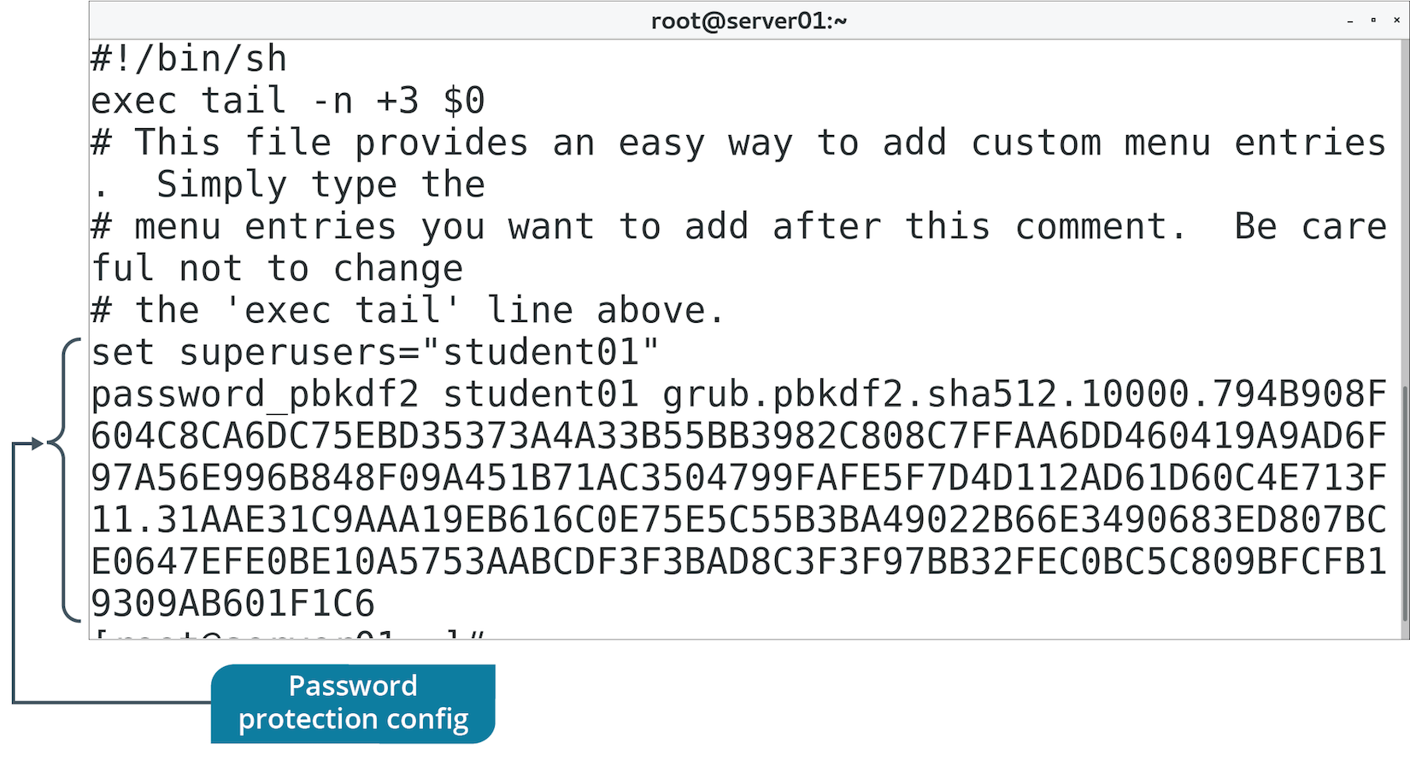
GRUB 2 Boot Menu Customization (Slide 2 of 2)

Slide 32
The /etc/default/grub File (Slide 1 of 2)
Contains display menu settings.
Read by /etc/grub.d/ scripts and built into grub.cfg file.
Enables you to change options such as:
How many seconds until GRUB 2 auto-selects default boot option.
Placement of kernel versions in sub-menus.
Display menu in graphical terminal.
And more.

Slide 33
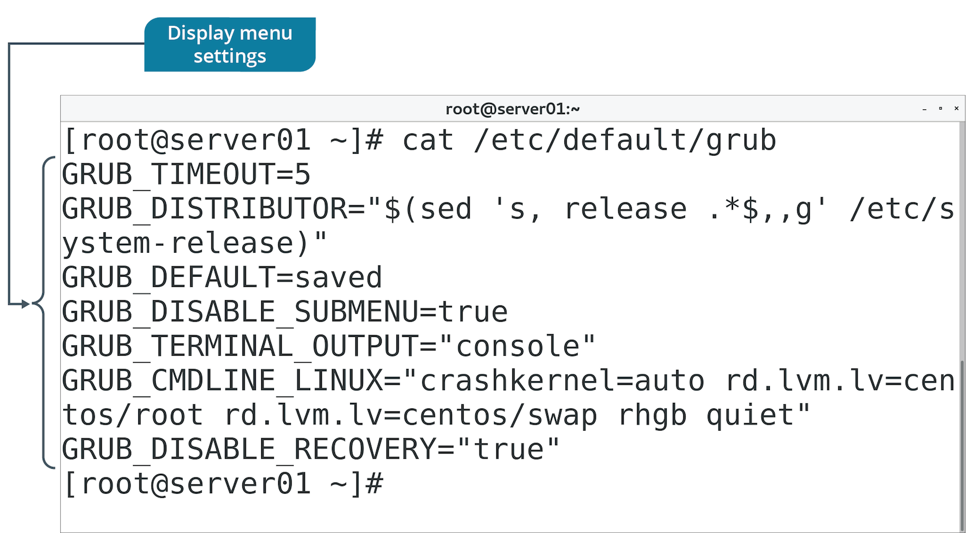
The /etc/default/grub File (Slide 2 of 2)

Slide 34
The grub2-mkconfig Command
Generates a new grub.cfg file.
Or, updates existing grub.cfg file.
Combines:
Configuration templates in /etc/grub.d/
Settings in /etc/default/grub
Uses both to generate grub.cfg file.

Slide 35
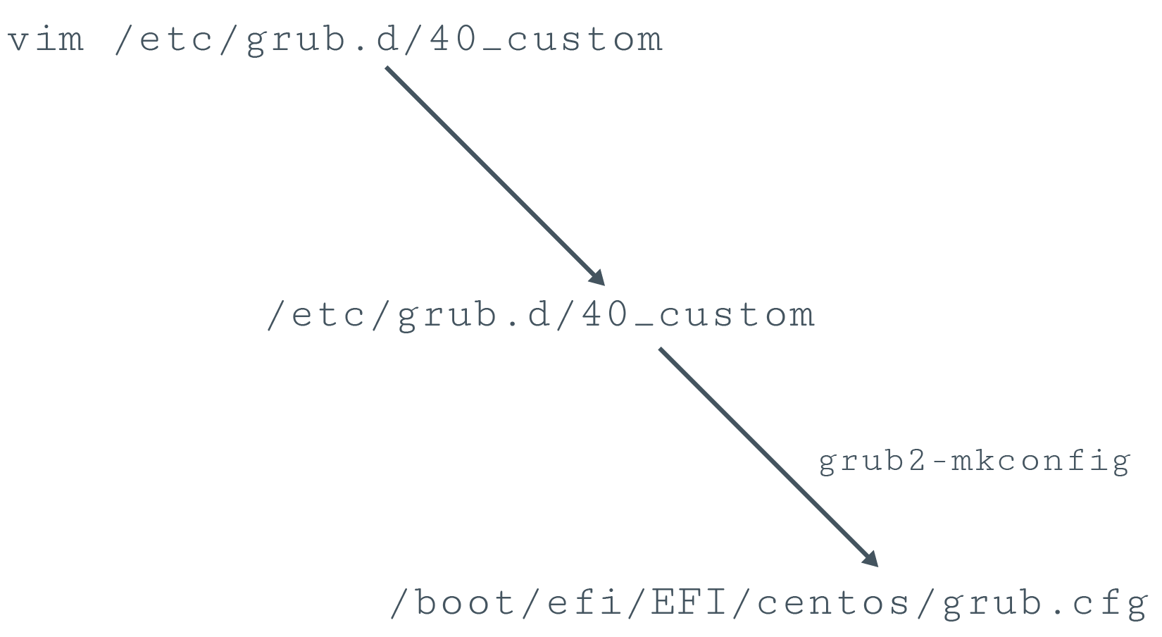
GRUB 2 Configuration Process (Slide 1 of 2)

Slide 36
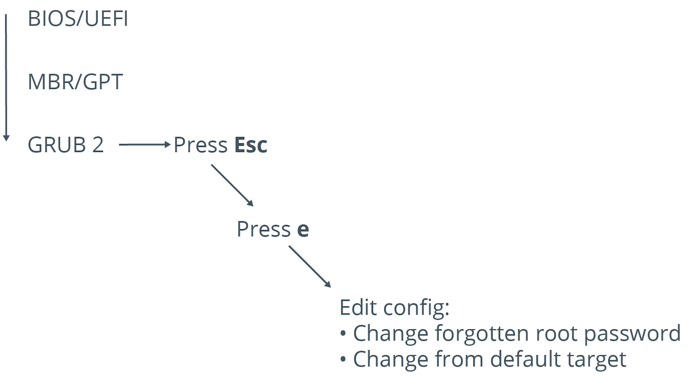
GRUB 2 Configuration Process (Slide 2 of 2)

Slide 37
Discussing GRUB 2

Slide 38
Activity: Configuring GRUB 2
Some Linux servers aren't booting properly.
You need to troubleshoot.
Someone modified boot loader settings.
You corrected the boot loader.
Now you need to password protect GRUB.

Slide 39
What boot options do you use or plan to use in your Linux environments? Why?
Do you anticipate the need to configure GRUB 2 in your environments? Why or why not?

